Slide 1
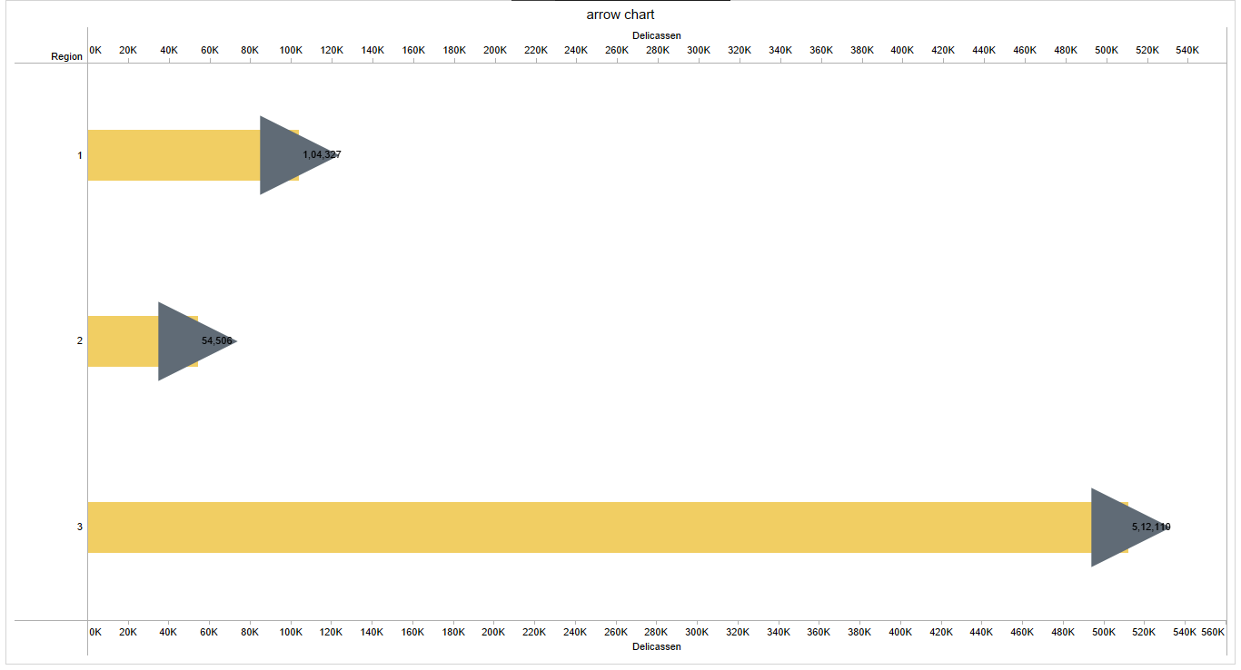
UNVEILING MARKET INSIGHTS ANALYING SPENDING BEHAVIOUR
ARROW CHART

Slide 2
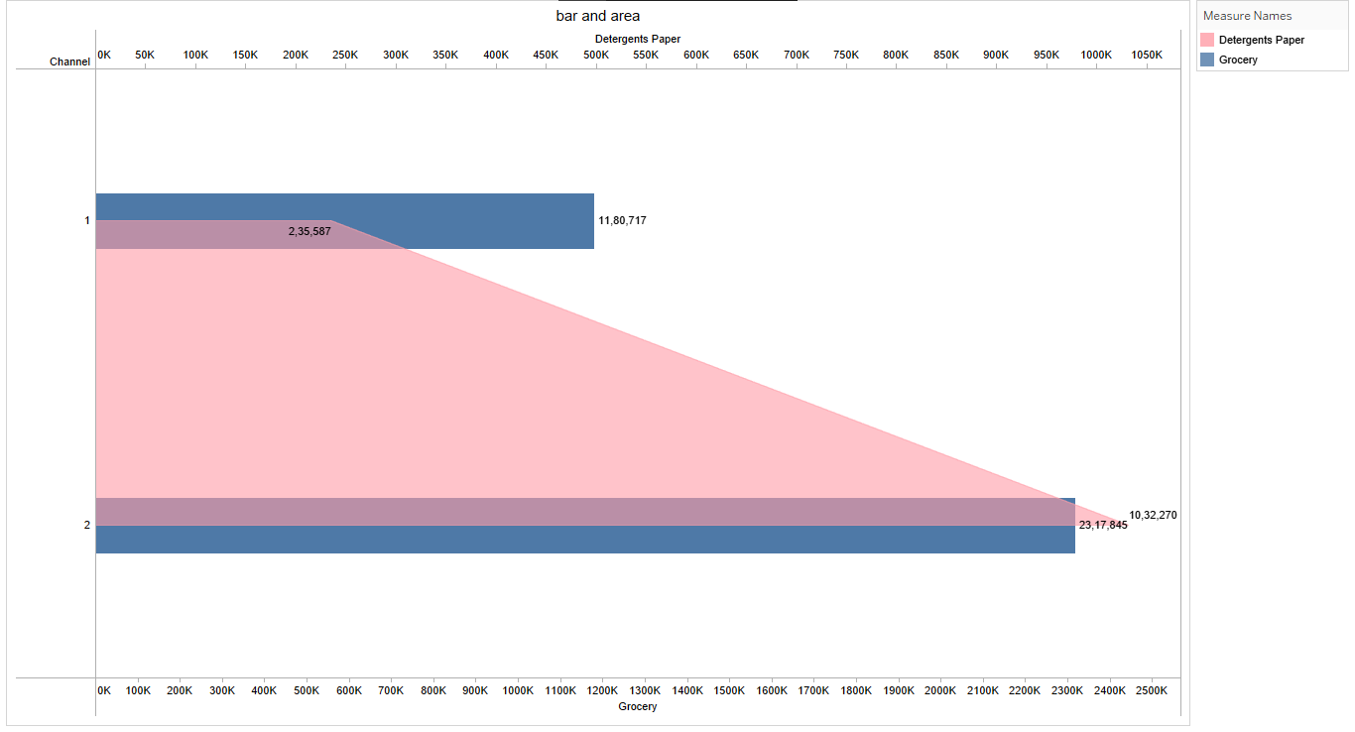
BAR AND AREA CHART

Slide 3
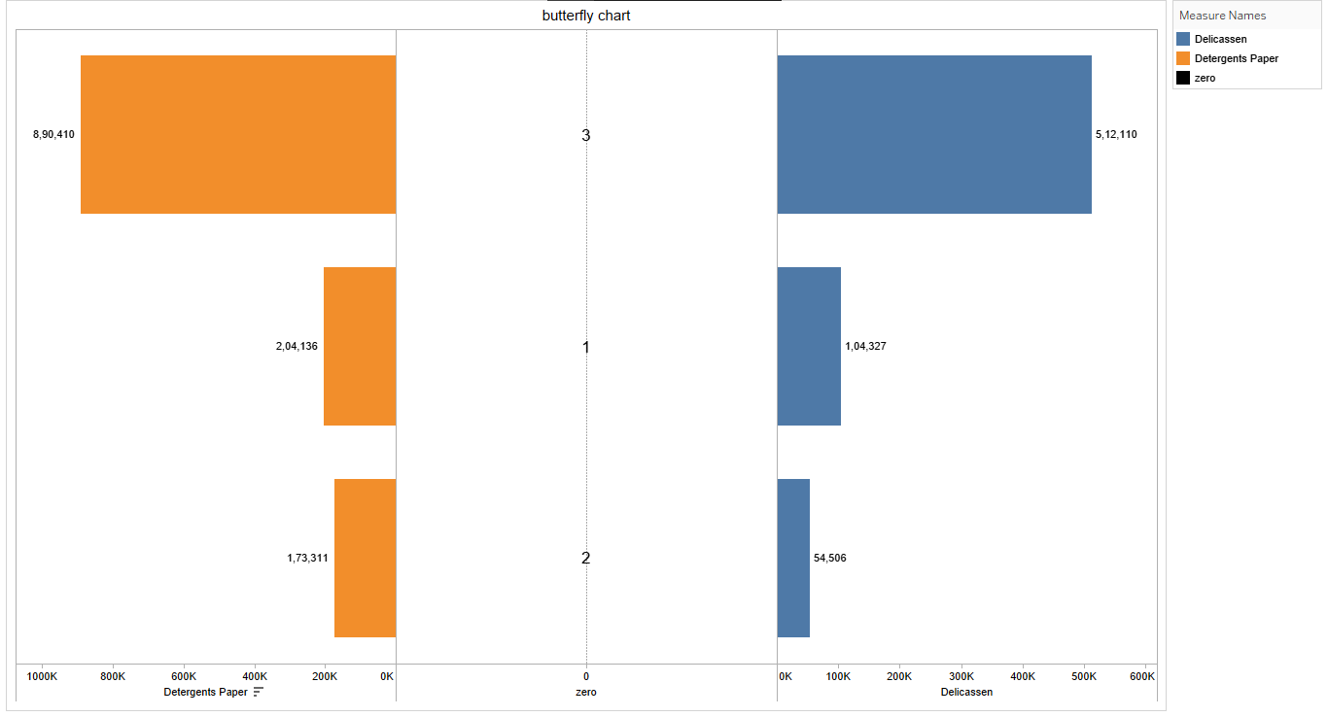
BUTTERFLY CHART

Slide 4
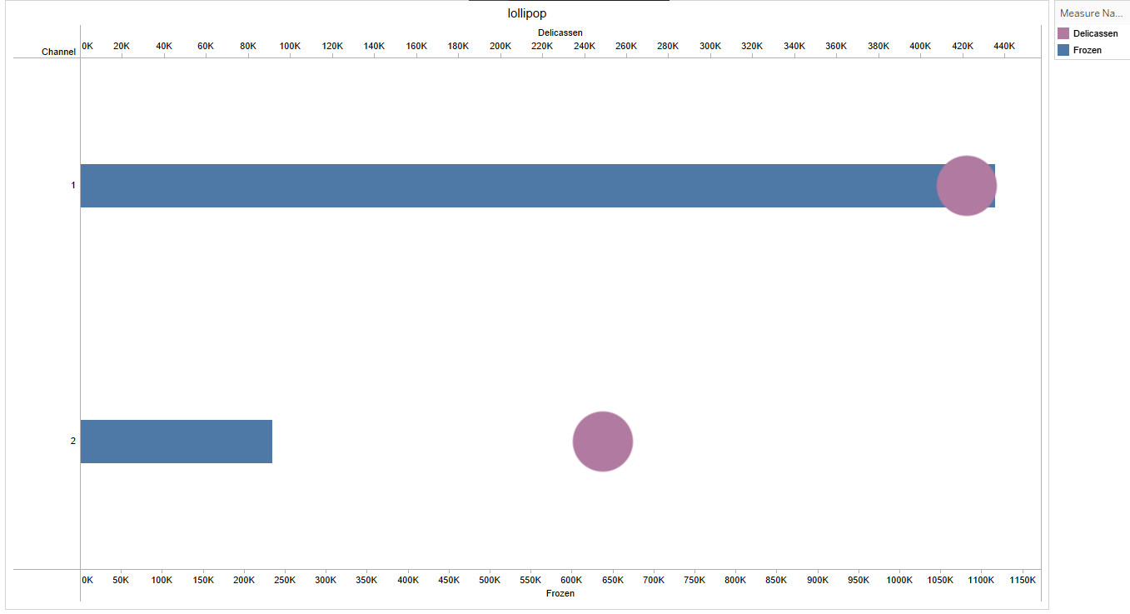
LOLLIPOP CHART

Slide 5
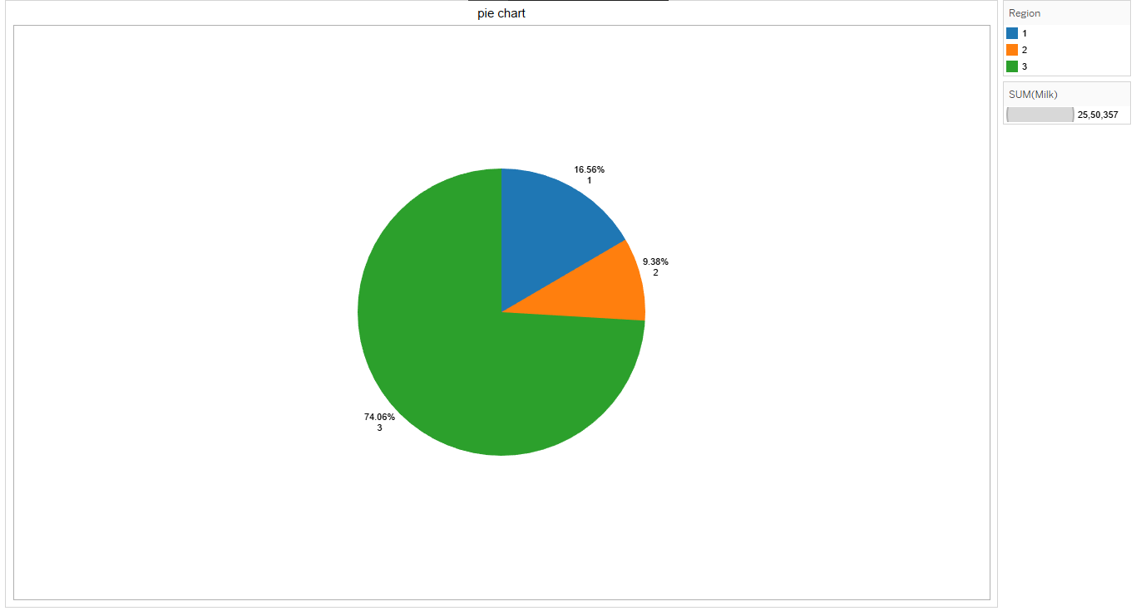
PIE CHART

Slide 6
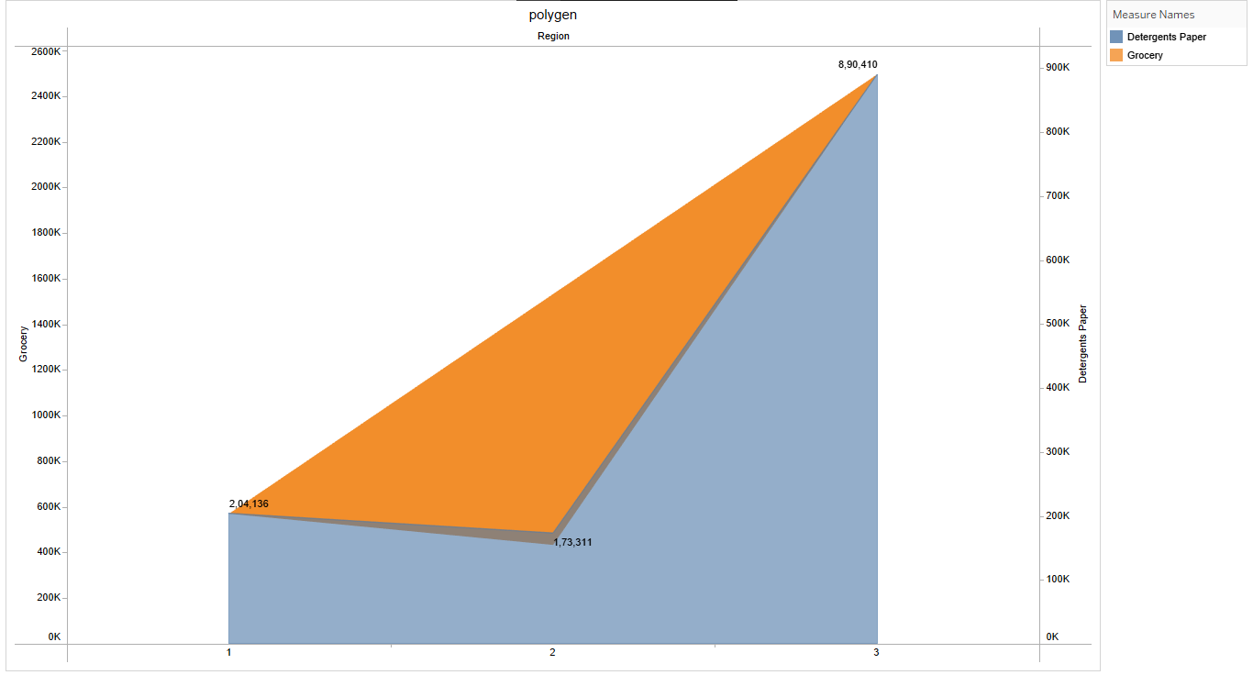
POLYGEN CHART

Slide 7
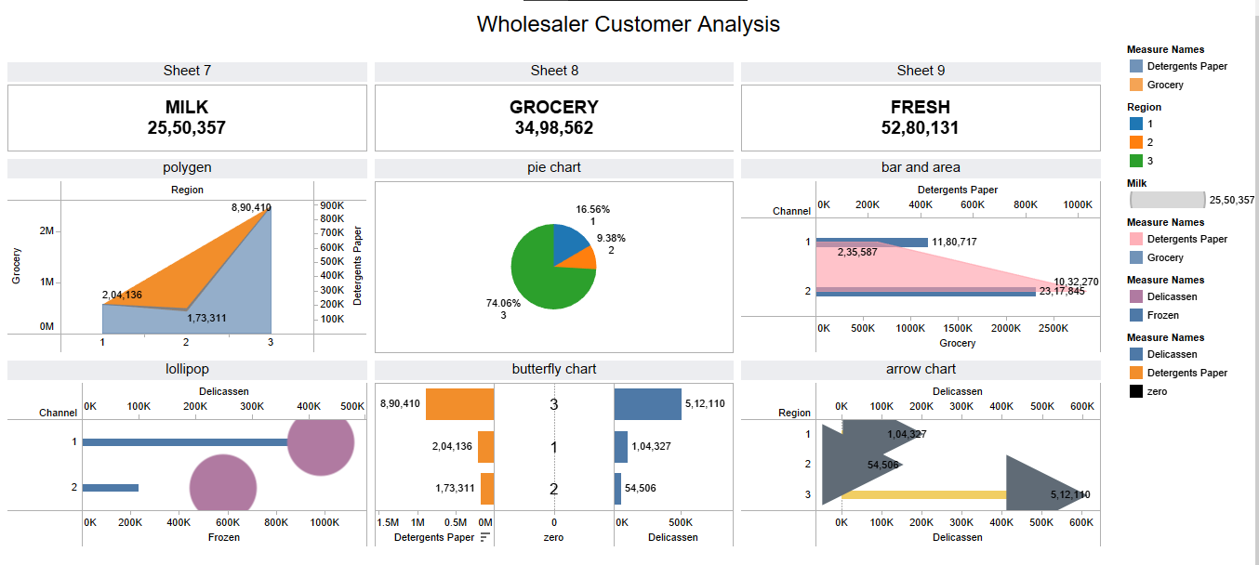
DASHBOARD

Slide 8
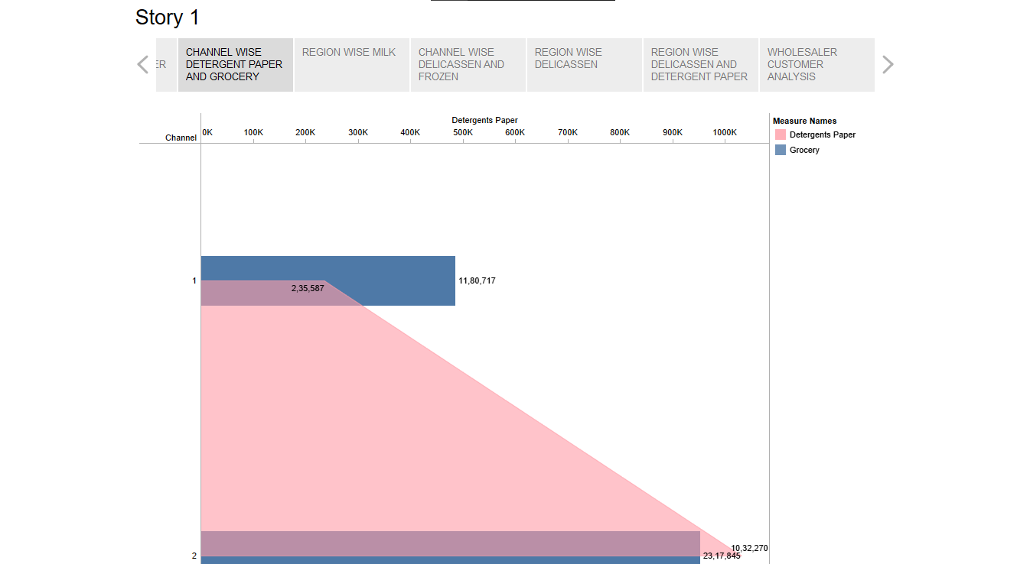
STORY

